Slide 1




Flutter – Lecture 5

Slide 2
Topics to be Covered
We will Cover :
What is Widget?
Widget Tree
Types of Widgets
Widgets State
Widgets Lifecycle
Notes:
Each element on a screen of the Flutter app is a widget. The view of the screen completely depends upon the choice and sequence of the widgets used to build the app. And the structure of the code of an app is a tree of widgets.
Category of Widgets: There are mainly 14 categories in which the flutter widgets are divided. They are mainly segregated on the basis of the functionality they provide in a flutter application.

Slide 3
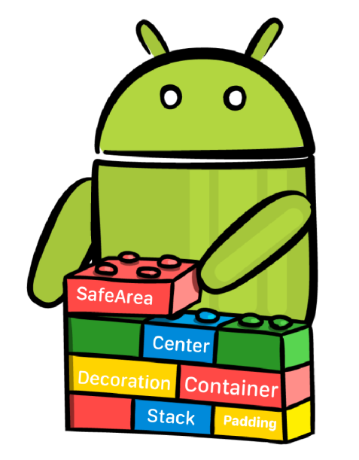
What is Widget?
Widget is the basic building block of Flutter apps.
User Interface in flutter is nothing more then arrangement of widgets.
Using widgets is like combining Legos. Like Legos, you can mix and match widgets to create something amazing.

Slide 4
What is Widget?
Each element on a screen of the flutter app is a widget, therefore whenever you are going to code for building anything in Flutter, it will be inside a widget.
To build an app Widgets are nested with each other.
Flutter has a rich set of in-built widgets like text, buttons, slider, lists, layouts, gesture detector, animations, etc.

Slide 5
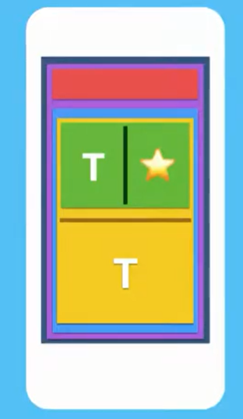
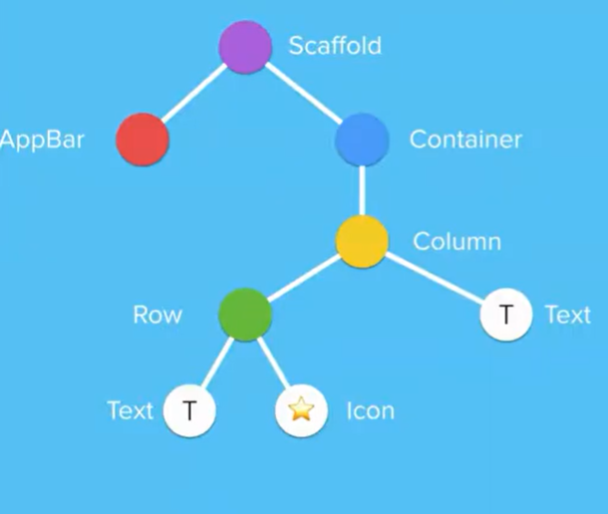
Widget Tree
To develop an interface in flutter, widgets are arranged into a tree of parent and child widget.
Widgets are nested inside of each other to form your app.
The Entire widget tree forms a layout that you see on the screen.

Slide 6
Types of Widgets
We can split the Flutter widget into two categories:
Visible (Output and Input): These widgets are related to the user input and output data. Some of the important are
Text, Button, Image, Icon etc.
Invisible (Layout and Control): The invisible widgets are related to the layout and control of widgets. It provides controlling how the widgets actually behave and how they will look onto the screen. some of the important are
Column, Row, Center, Padding, Scaffold, Stack

Slide 7
Widget State Management
State is information that
can be read synchronously when the widget is built
and might change during the lifetime of the widget.
In other words, a state is a data that a widget can hold, which is available after the widget is rendered/rebuilt.
In Flutter, there are mainly two types of widget:
Stateless Widget
Stateful Widget

Slide 8
Stateless Widget
These do not have state information. It remains static throughout its lifecycle.
Stateless widgets don’t store any state. That means they don’t store values that might change.
You can also say that stateless widgets are “DATALESS” widgets. As they don’t store any real-time data.
For example, if you have a simple Text widget on the screen, but it doesn’t do anything then its Stateless Widget.
Examples are Text, Row, Column, Container, etc. This is also known as Immutable state that can NOT be changed during runtime.

Slide 9
Stateful widget
These are dynamic because it can change the inner data during the widget lifetime.
The user can interact with a stateful widget. For example, If you press a button and it performs any task its a Stateful Widget, If you are moving a slider and it does anything then its a Stateful Widget, If you swipe item from a list and item gets deleted then that list a Stateful Widget.
Examples: Checkbox, Radio, Slider, InkWell, Form, and TextField.

Slide 10
Widget Lifecycle
The lifecycle of the Flutter App is the show of how the application will change its State. As we know, Everything in Flutter is a Widget, and Widgets can be
Stateless Widgets: Stateless Widgets don’t change their state at runtime. To represent a widget in stateless
class MyApp extends StatelessWidget { @override Widget build(BuildContext context) { return Container();}}
Stateful Widgets: Stateless widgets can change their state at runtime. To represent a widget in statefull
class MyApp extends StatefulWidget { @override _MyAppState createState() => _MyAppState(); } class _MyAppState extends State<MyApp> { @override Widget build(BuildContext context) { return Container();}}

Slide 11
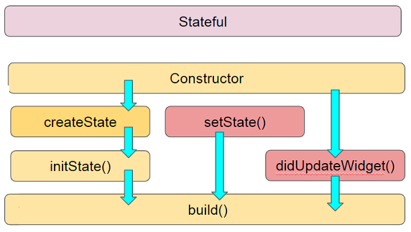
Stateful Widget Lifecycle
createState: When the Framework is instructed to build a StatefulWidget, it immediately calls createState()
initState(): Called when this object is inserted into the tree. It called only once in widget life. Here you can do some initialization, such as initialization State variables.
didUpdateWidget(): Called whenever the widget configuration changes
setState(): called often from the Flutter framework itself and from the developer.
build: This is main function and called each time, when we need to render the UI Widgets on the screen
Notes:
A stateful widget is dynamic: for example, it can change its appearance in response to events triggered by user interactions or when it receives data. Checkbox , Radio , Slider , InkWell , Form , and TextField are examples of stateful widgets.

Slide 12
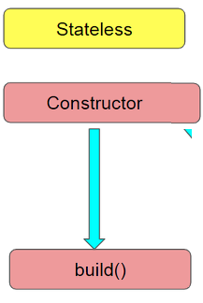
Stateless Widget Lifecycle
Stateless Widget Lifecycle consist only build() function. It has no state, so they can’t change according to an internal state, they only react to higher widget changes.
The build function in the widget creates the content to be displayed on the screen.
Notes:
A stateless widget is a widget that describes part of the user interface by building a constellation of other widgets that describe the user interface

Slide 13
Layout Widgets
Layout is a user interface design pattern refers to defining how the widgets are displayed on the screen relative to each other.
Flutter categories layout widgets into two types
Single Child Widget
Multi Child Widget

Slide 14
Summary
Today we have learned about:
What is Widget?
Widget Tree
Types of Widgets
Widgets State Management
Stateless Widget
Stateful widget
Widgets Lifecycle
Layout Widgets

Slide 15
In Next Lecture:
We will Cover:
Single Child Widgets
Text
Button
Image
Icon
TextField

